Slide 1
Adxstudio Portals Training
Portal Theming

Slide 2
Front-End Framework
Adxstudio Portals uses a front-end framework in all our starter portals
This refers to the structure of HTML and the elements and CSS styles used
Provides an easy to use platform for designers
Many elements built Out of the Box to save on design time
Responsive CSS Out of the Box
Front-end framework built upon Bootstrap

Slide 3
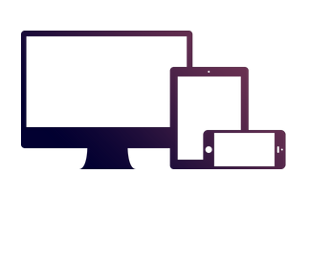

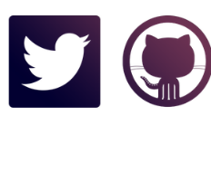
Bootstrap
Components
Version 6.0 of Portals
Includes CSS and Javascript components for common web application interface elements:
Provides an ecosystem that you can take advantage of to quickly and easily theme the portals and features to suit your brand
2.3.2
Latest Version
Responsive CSS
Bootstrap was made to not only look and behave great in the latest desktop browsers, but in tablet and smartphone browsers via responsive CSS as well.
3.3.1
Web community
Built at Twitter by @mdo and @fat, Using LESS CSS, managed through GitHub

Slide 4
Using Bootstrap with Adxstudio Portals
Code-Generated Themes
Includes variables for:
Navigation elements
Forms
Buttons, tables, alerts, inputs
Responsive grid layout system
Bootstrap uses a set of variables to apply behavior to elements of the portals

Slide 5
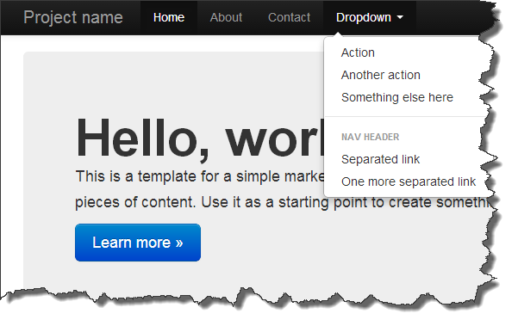
Using Bootstrap with Adxstudio Portals
Elements include:
Base styles
Classes
Special Structured components
JavaScript Components
Scaffolding

Slide 6
Mobile Applications
Primarily through the use of standard bootstrap elements, all Adxstudio Start Portals are mobile-ready
Responsive CSS dynamically adjusts layout as window is resized, changing the position and form of components
Use the OOB scaffolding technique as documented on the bootstrap website

Slide 7
Customizing Bootstrap
By its use of variables to generate its styles and Javascript, bootstrap can be easily customized in order to apply a consistent look throughout your portal
Customize bootstrap first, then tweak the styles that are generated (by adding your own on top)
ThemeRoller, Bootswatchr, BootTheme

Slide 8
Theming the Portal
A custom version of bootstrap will generate a bootstrap.min.css file (along with possibly other files)
You can overwrite the corresponding file in your web project if you wish, but better to use a web file
Upload as a web file to the homepage (partial url: bootstrap.min.css) to apply your custom bootstrap theme to entire portal
Can upload other CSS files as well
CSS files uploaded will apply to the page they are parented by and all child pages of that page

